Slide 1

Final Project: Animal Kingdom Instructor: DR. HADI NAGHAVIPOUR Student name: LEE LAY PENG Student id: Mc220316722
ITWM5113 SOFTWARE DESIGN AND DEVELOPMENT

Slide 2
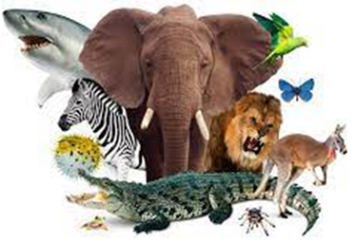
AGENDA
1. Introduction​
2.Project Description
3.Project Design
4.Project Workflow and Logics
​5.Critter Stimulation & Result
6. Conclusion

Slide 3
1. Introduction

Slide 4
1. Introduction
Project involves writing classes for specific animals: Bear, Giant, NinjaCat, Tiger & WhiteTiger
Defines behavior of animals including actions, colors, and string representations
Practice creating classes that characterize different animals
Project provides Java files, task is to incorporate behavior codes into project file
Compiled and run project displays simulation window representing animal behavior for review

Slide 5
OOP Principles
OOP is a programming paradigm that emphasizes the use of objects to represent data and behavior. OOP principles include encapsulation, inheritance, and polymorphism.
Encapsulation: The code is organized into separate classes, each with their own responsibilities and methods, to help keep the code modular and maintainable.
Inheritance: The class hierarchy is set up using inheritance to help share common functionality between classes and to make it easier to add new classes in the future.
Polymorphism: The use of interfaces and abstract classes allows for different classes to share the same methods and for the program to be more flexible and extensible.
Abstraction: The use of abstract classes and interfaces helps to abstract away details that are not important to the overall functionality of the program, making the code easier to understand and maintain.

Slide 6
2. Project description

Slide 7
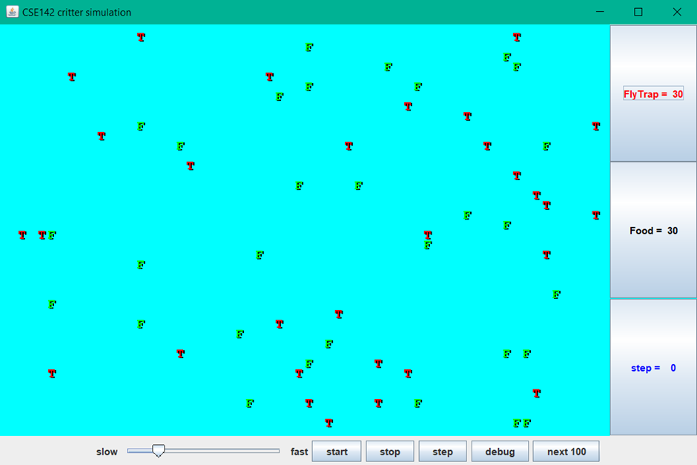
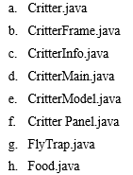
For this project, we are given a program that runs a simulation of a world with many animals wandering around in it.
Different kinds of animals will behave in different ways.
8 Files Provided:
Initially, there will be 2 existing critter: Fly Trap and Food Classes
Need to write classes for specific animals: Bear, Giant, NinjaCat, Tiger & WhiteTiger

Slide 8
3. Project design

Slide 9
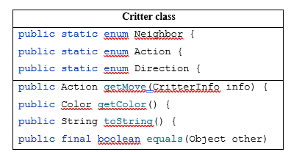
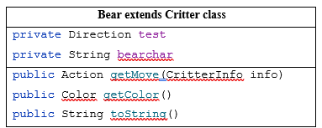
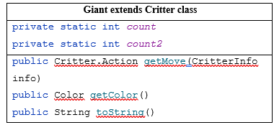
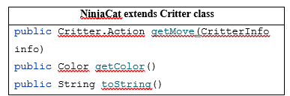
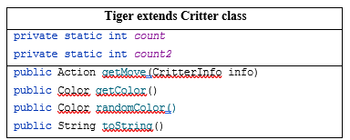
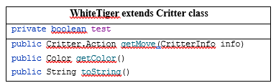
We determine the type of the relationship between provided classes, the relationship between sub classes and parent class is "IS-A" relationship. In object-oriented programming, the concept of IS-A is a totally based on Inheritance.
The methods in the sub-classes will be overriding the method it inherited from the Critter class, to implement the change of behavior of each sub-class. The following will be the methods and functions for each class as detailed in the source code

Slide 10
4. Project Workflow and Logics

Slide 11
Project workflow
Mainly done separately for each class.
As the methods in each of the sub-class will be overriding the Critter class.
So, the program of the data inputted in each class will be handled separately and modified in each class.

Slide 12
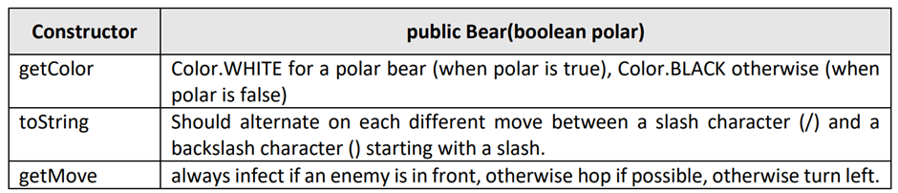
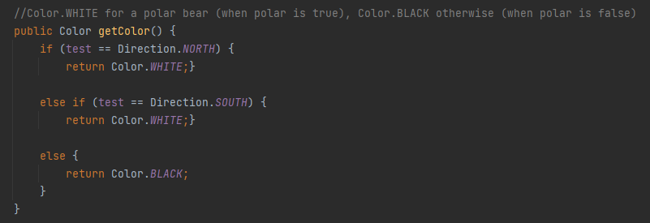
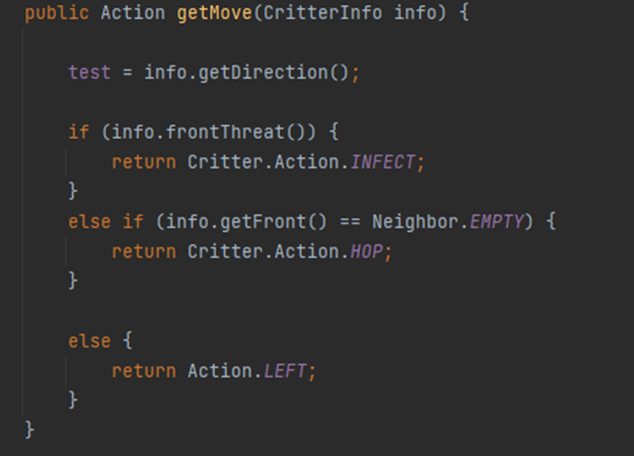
1. Bear Class

Slide 13
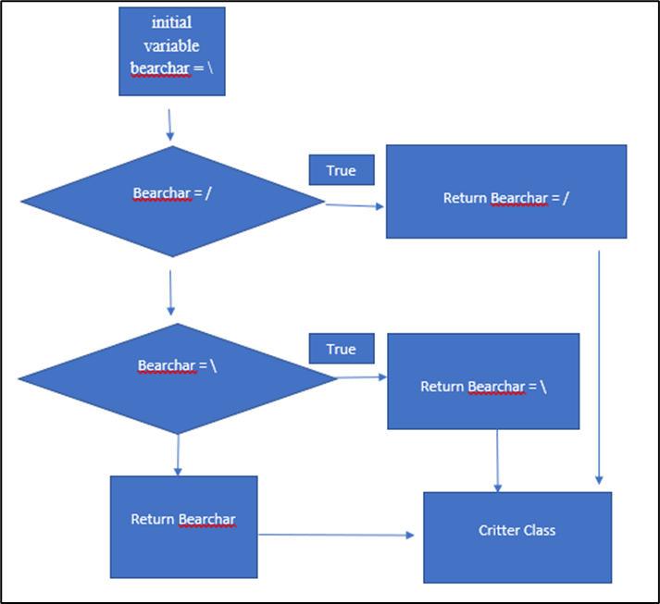
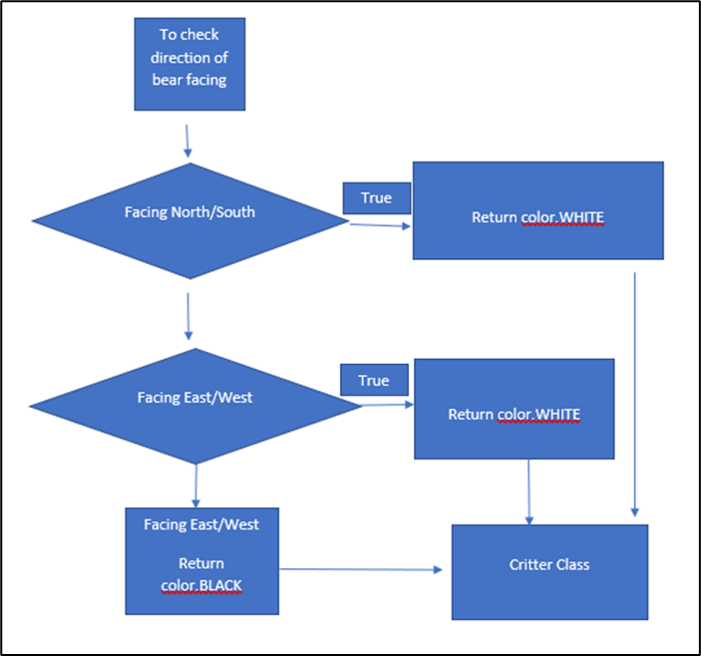
getMove Constructor flow chart for Bear class
getColour Constructor flow chart for Bear class

Slide 14
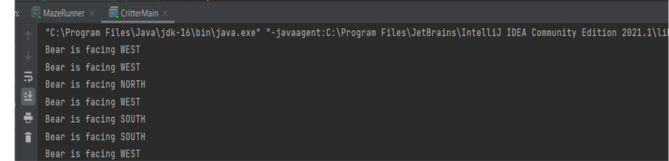
To determine the color of the bear, a direction variable test has been created to accept the value of each bear to check to which direction it is facing.
A test println command is used to check what is the direction for each critter. Then and if else condition was implemented in the getColor to return the value of color for each bear depending on its direction it facing to the Critter class.
As for the toString method to determine the string to represent the critter bear, an initial string variable of “bearchar” has been initiated as forward slash (\). If else, condition is used to alternate the string between (/) and (\).
For getMove, the requirement is “always infect if an enemy is in front, otherwise hop if possible, otherwise turn left.” In order do this, below input from the surroundings of the critter is explained.
info.frontThreat() == true - if an enemy is in front
info.getFront() == Neighbor.EMPTY -there is nothing in front

Slide 15
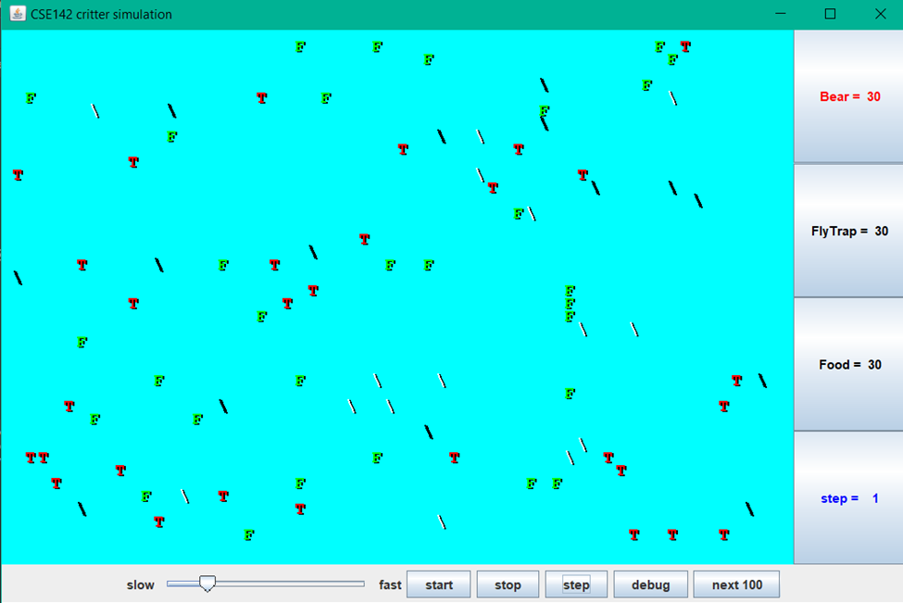
1. Bear Class

Slide 16
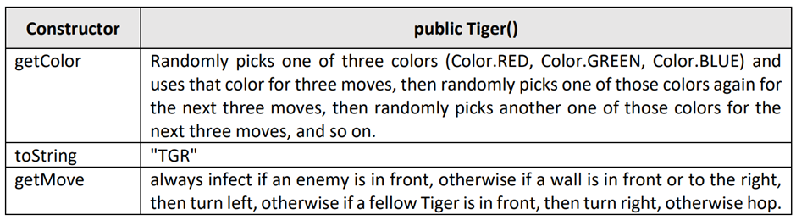
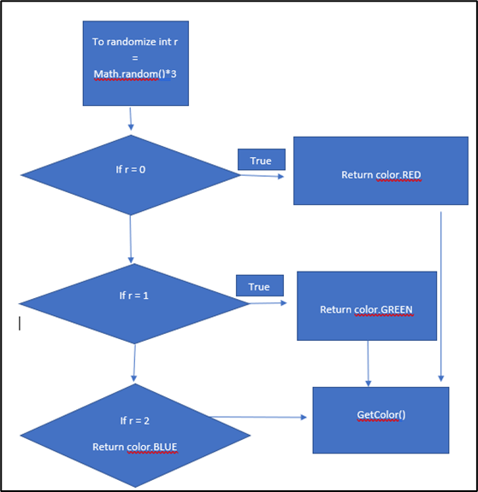
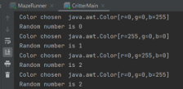
2. tiger Class
A test println command is used to check if the randomize function works and the randomize number will pinpoint to one out of all three color red, green and blue. Then, the color will pass to the getcolor() method and to pass to critter class.
For toString, this is a straightforward to override the Critter class with the string “TGR”z.
For getMove, the tiger will always infect if an enemy is in front, otherwise if a wall is in front or to the right, then turn left, otherwise if a fellow Tiger is in front, then turn right, otherwise hop.
getColor Constructor flow chart for Tiger Class

Slide 17
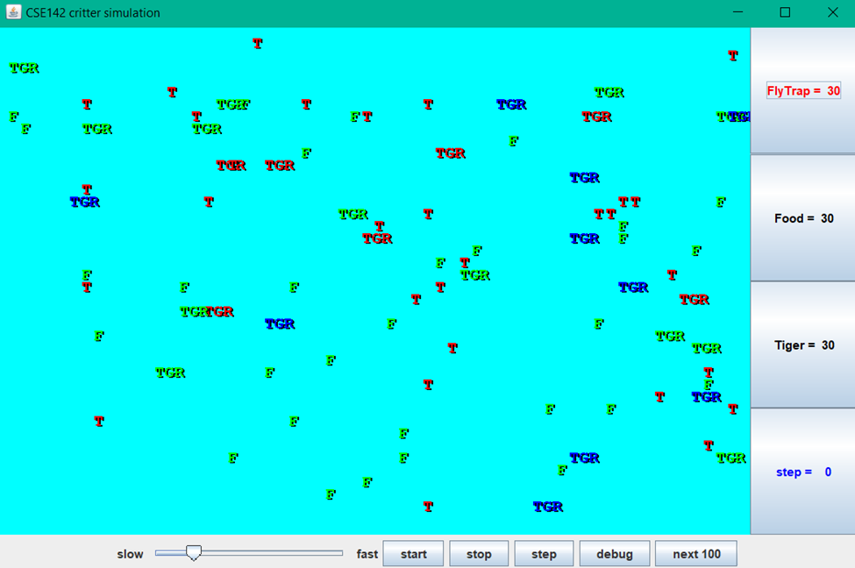
2. tiger Class

Slide 18
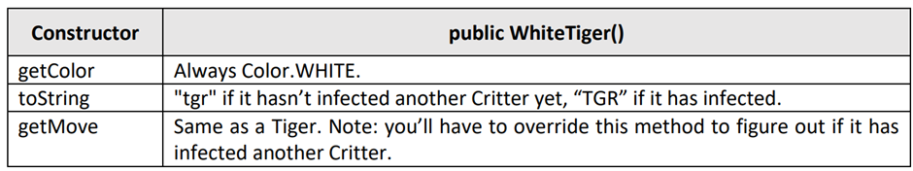
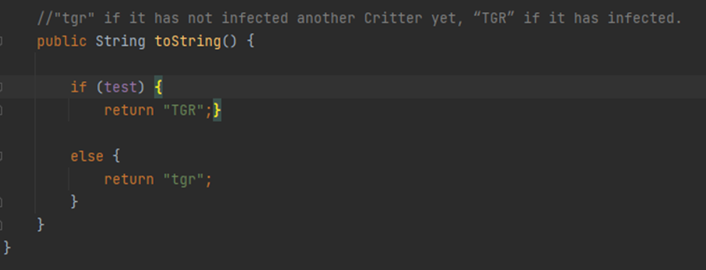
3. White tiger Class
Boolean variable test is introduced to recognized if there is any enemy in front of the WhiteTiger and infected the enemy.
If true, this will be passed down to the ToString () method.
If the test variable true will make the WhiteTiger string as TGR and lowercase tgr otherwise as shown below:

Slide 19
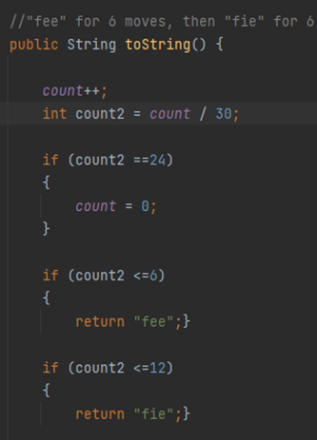
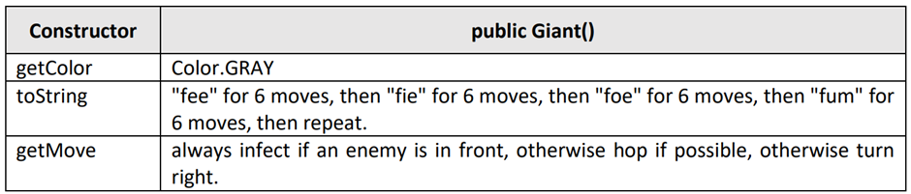
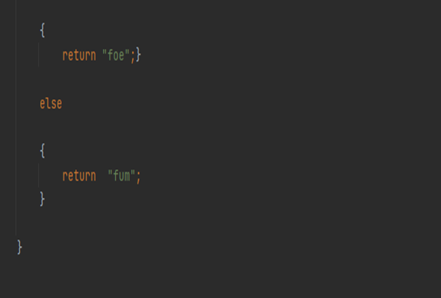
4. giant Class
To complete this to Stringmethod two counter (count and count2) variables have been initiated.
The first counter is to count the number of the critter, and once the critter reaches 30, the next counter will divide the critter number to 30, this will show the step counter. The step counter is important to determine that once the step counter reaches 6 it will pass a different string to the critter class.

Slide 20
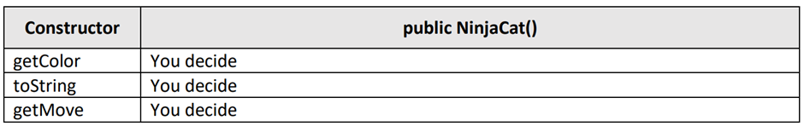
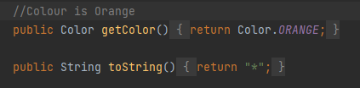
5. Ninja cat Class
getColor – Color.ORANGE
toString – “*”
getMove - Always infect if any other than NinjaCat is in front, Right, Left and Back. Also always infect if an enemy is in front, Right, Left and Back, then, if Wall on the right or in front turn left, if meet Ninja Cat in front turn right and if in front is empty space then hop, if possible, otherwise hop again.

Slide 21
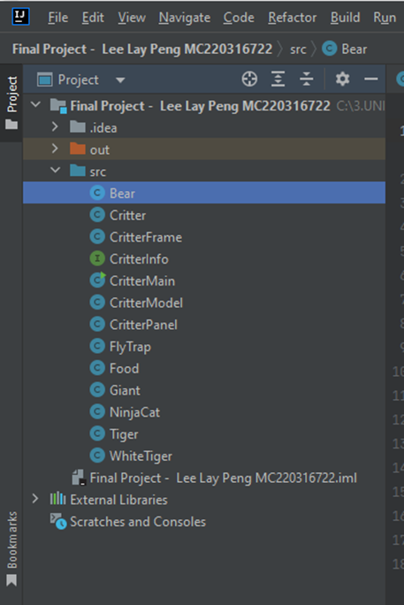


Slide 22
5. Critter Stimulation & Result

Slide 23
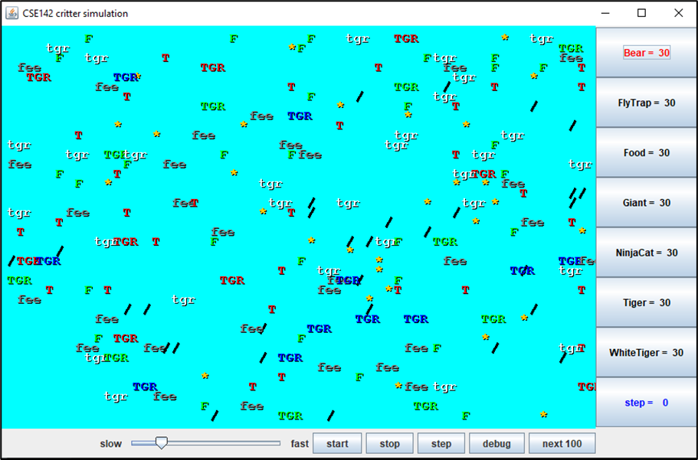
Before Initiate

Slide 24
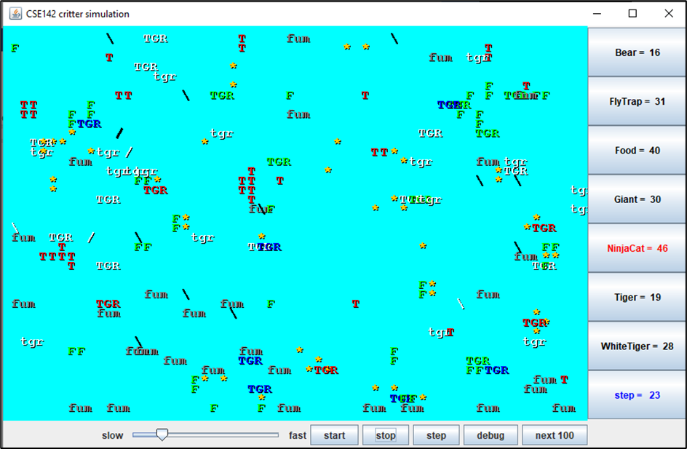
Initiate, Animal starts roaming

Slide 25
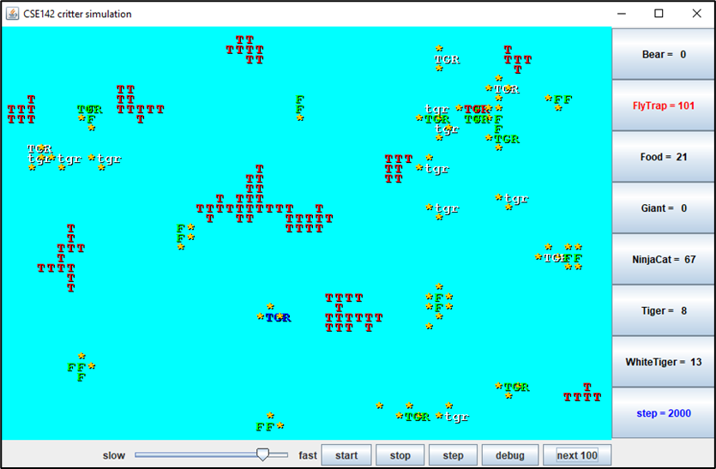
UPON 200 steps
FlyTrap performed exceptionally well (101) compared to the other animals, followed by NinjaCat (67)
Bear and Giant went extinct completely (0).
The Tiger (8) and White Tiger (13) species barely survived.
In essence, the results show that all the animal classes performed effectively.

Slide 26
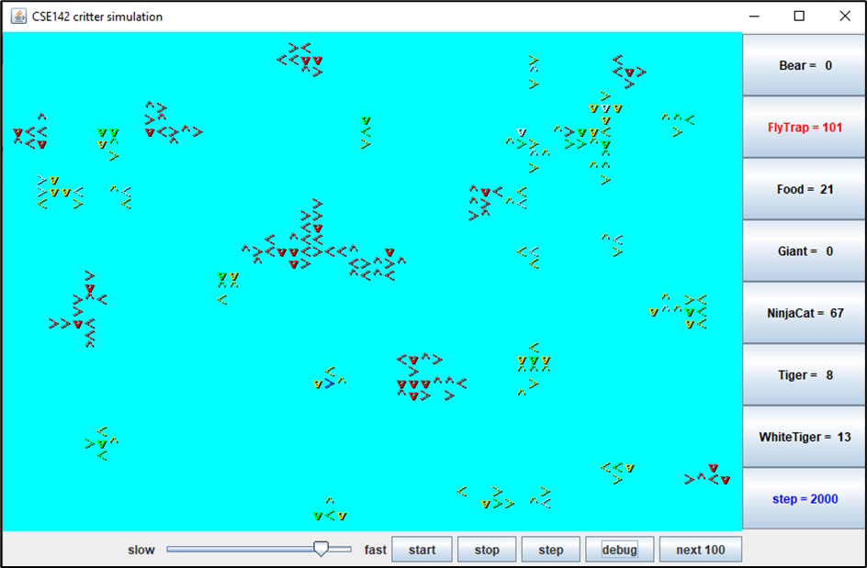
In debug mode
to observe the movement of the animals

Slide 27
6. conclusion

Slide 28
Understanding of object-oriented programming in Java has improved
Classes can be inherited by subclasses, inheriting variables and methods from parent class
Methods in parent class can be overridden by subclasses
Animal subclasses demonstrate overriding of methods to update default values
Successful implementation of variable value manipulation

Slide 29


